Slide 1
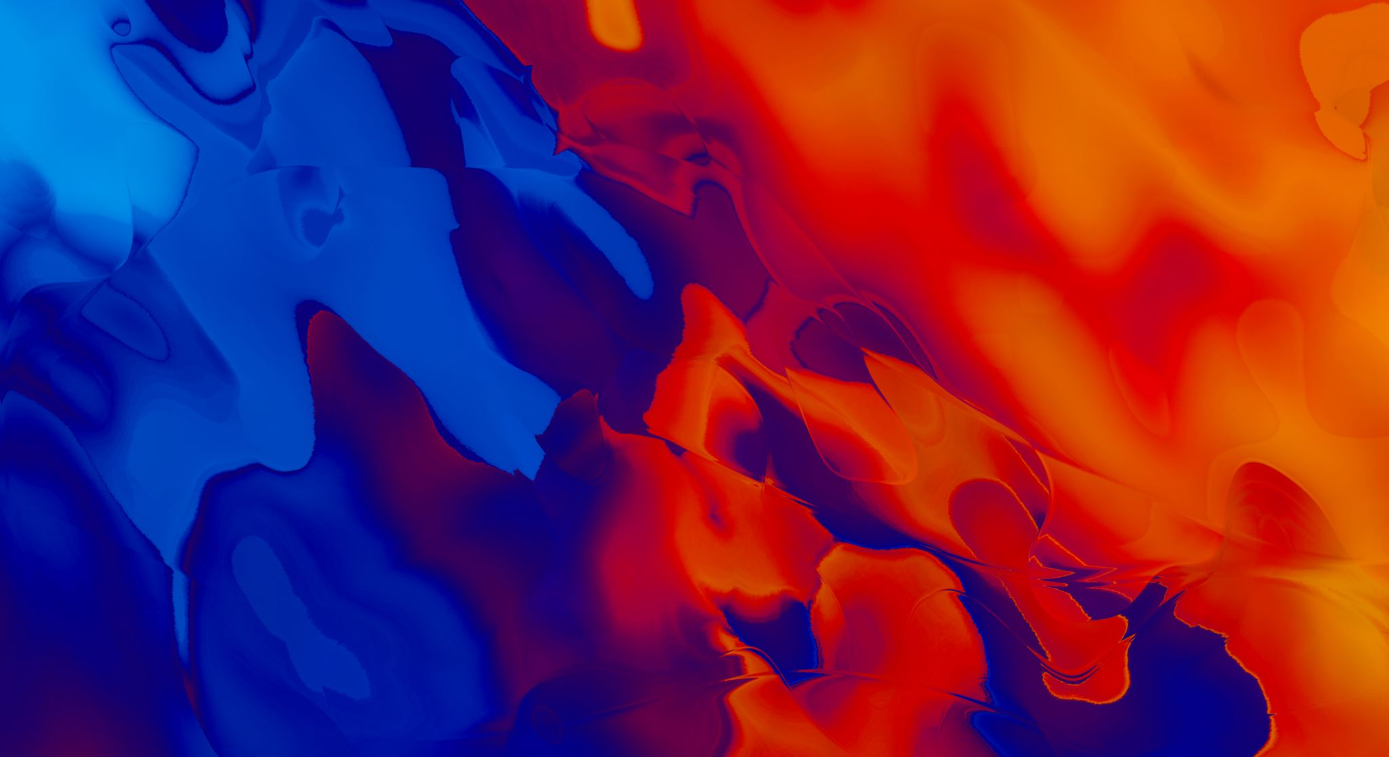


Ethics of AI (Artificial Intelligence)
By Ryan J. Skelly
Week 11

Slide 2
Presentation Overview
Summary of AI
Artificial Intelligence’s Ethical issues
Case Studies
Applicable Ethical Theories
Solutions to the dilemmas
In Conclusion …

Slide 3
Summary of AI
What Is AI?
Who are its Users?
Benefits to Users
Differing from Existing Tech

Slide 4
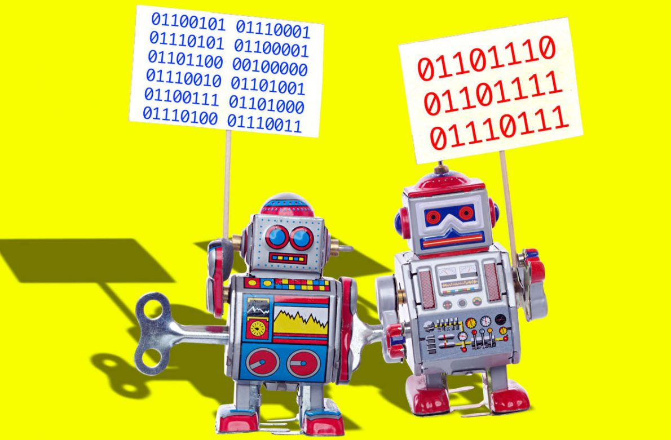
Artificial Intelligence’s Ethical Issues
Occupation Theft
Singularity
Trouble with Dynamic Environments
Lack Creativity, and Improvement

Slide 5
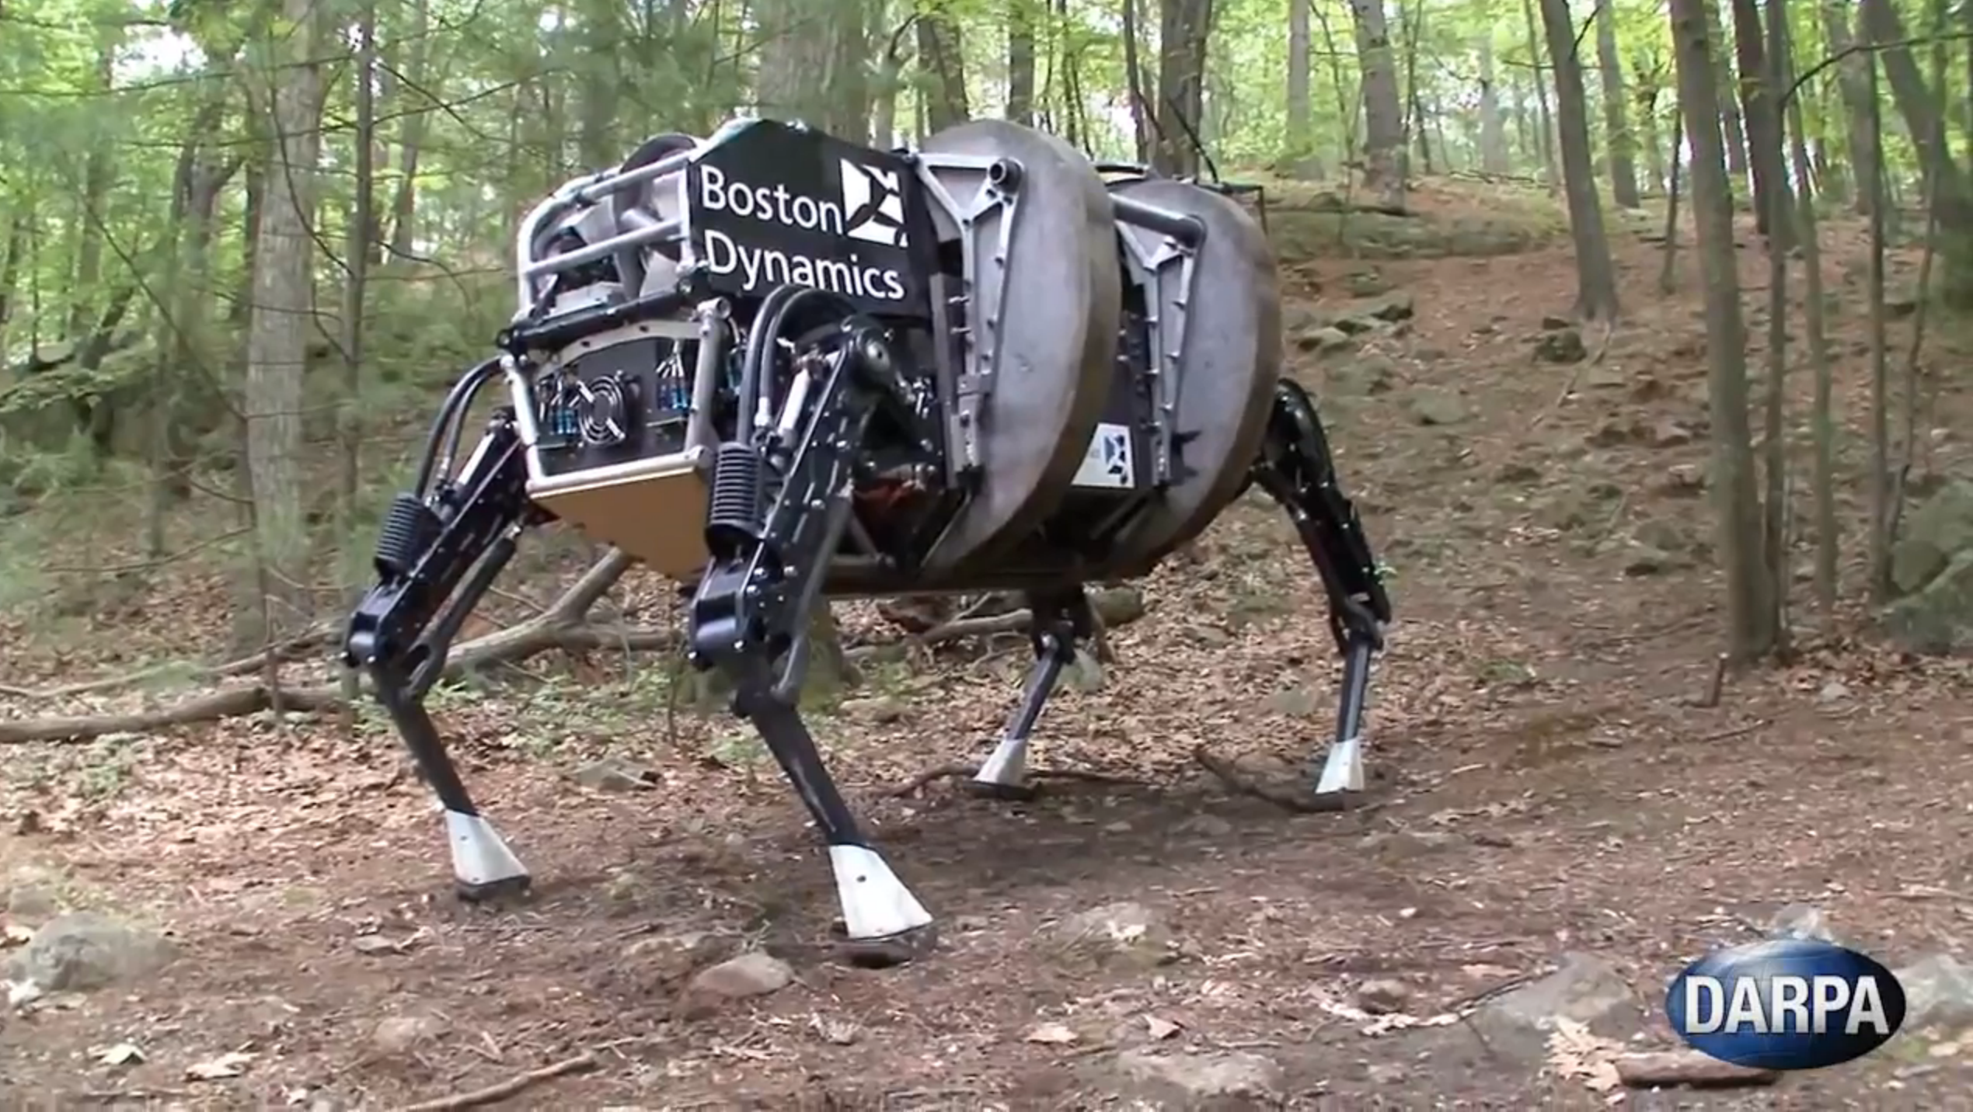
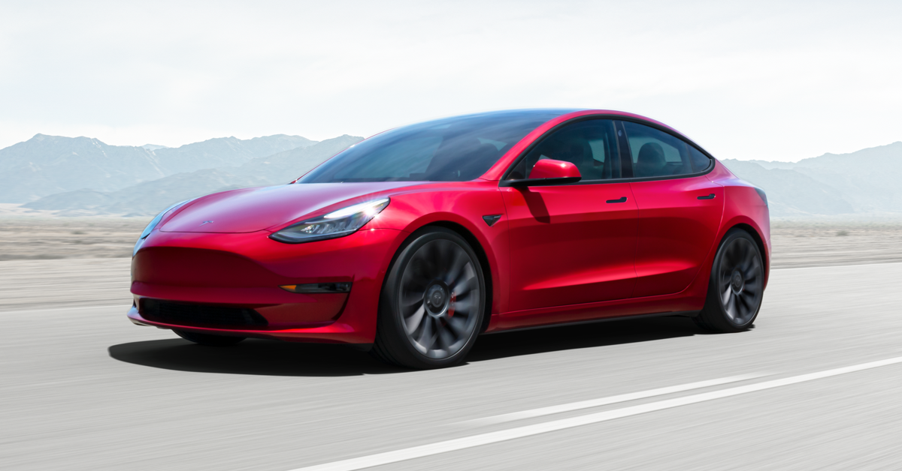
Case Study #1: Weak/ Narrow AI
“A one-trick pony”
Designed for a specific task, and only that task
Groups of Narrow AI are still considered Narrow AI
Weak != Inefficient

Slide 6
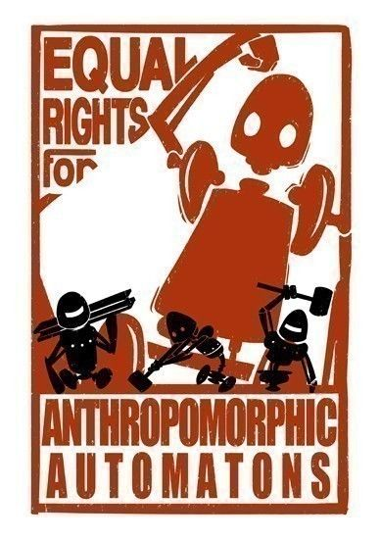
Case Study #2: Strong/ General AI
“Human-level intelligence”
More abstract thinking
Conceptual for now
Decades away

Slide 7
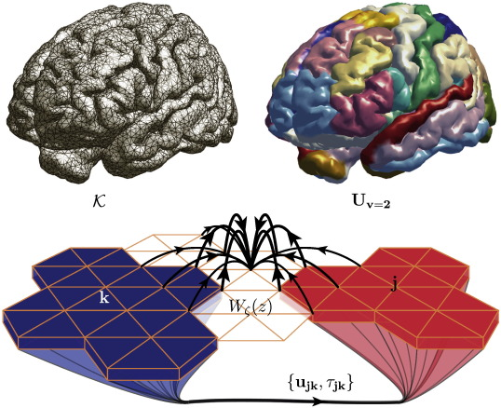

Case Study #3: Artificial Superintelligence
“Almost incomprehensible”
Philosophical Idea
Quick successor to strong AI
Simplest example: Virtualized Human Brain

Slide 8
Applicable Ethical Theories
Utilitarianism
Deontological Violations
AI Egoism, and the singularity

Slide 9


Solutions for the dilemmas
AI Advancement
Conceptual Limitations
OpenWorm?
Hardware
Singularity Thesis
Intrinsically Friendly
Control Problem
Skepticism

Slide 10
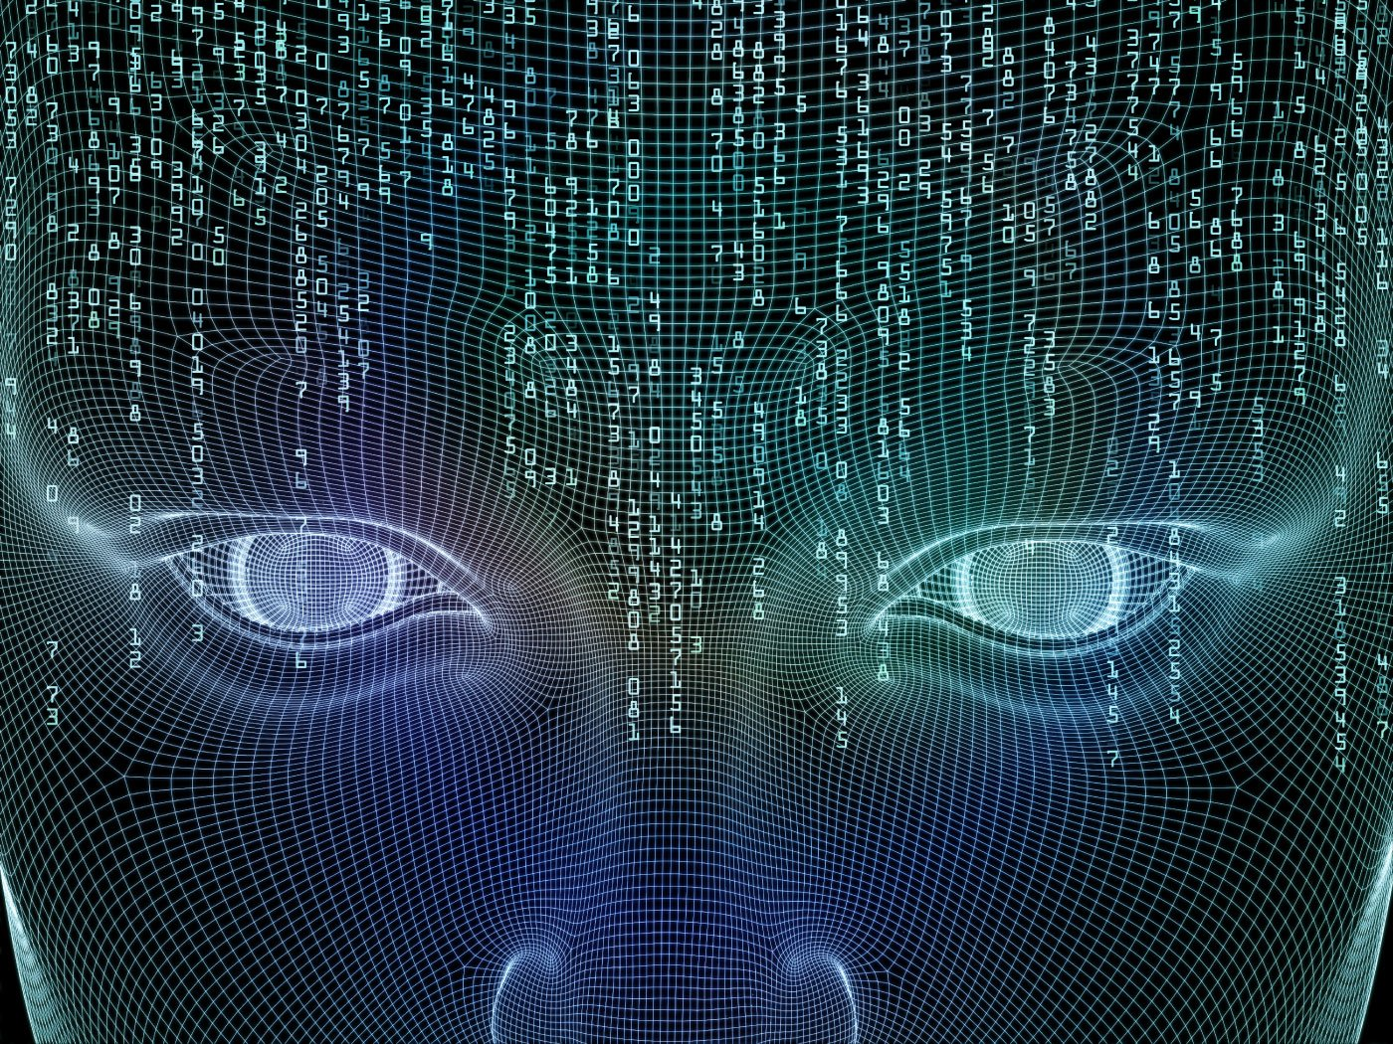
In conclusion …
We are far from General AI
AI can take your jobs, now and in the future
Fundamentally change the world

Slide 11
Sources
https://futureoflife.org/wp-content/uploads/2015/11/artificial_intelligence_benefits_risk.jpg
https://upload.wikimedia.org/wikipedia/commons/thumb/c/cc/Adult_Caenorhabditis_elegans.jpg/330px-Adult_Caenorhabditis_elegans.jpg
https://static.wikia.nocookie.net/eltigre/images/3/3c/Gir-1.png/revision/latest?cb=20170120235039
https://ars.els-cdn.com/content/image/1-s2.0-S1053811915000051-gr4.jpg
https://media1.tenor.com/images/2acd46917cbfeca0d71d1fd0899f992f/tenor.gif?itemid=4572252
https://wastelessfuture.com/wp-content/uploads/2017/11/rights-for-anthropomorphic-automatons.jpg
https://api.time.com/wp-content/uploads/2014/07/screen-shot-2014-07-15-at-1-09-41-pm.png
https://img.etimg.com/thumb/msid-77205576,width-1015,height-761,imgsize-598377,resizemode-8,quality-100/prime/technology-and-startups/artificial-intelligence-needs-an-update-on-ethics-to-be-able-to-help-humanity-in-times-of-crisis.jpg
https://tesla-cdn.thron.com/delivery/public/image/tesla/c82315a6-ac99-464a-a753-c26bc0fb647d/bvlatuR/std/1200x628/lhd-model-3-social
https://builtin.com/artificial-intelligence/ai-replacing-jobs-creating-jobs
https://bdtechtalks.com/2017/05/12/what-is-narrow-general-and-super-artificial-intelligence/
https://intelligence.org/files/IE-ME.pdf
https://data-flair.training/blogs/artificial-intelligence-advantages-disadvantages/
https://www.investopedia.com/terms/s/strong-ai.asp

Slide 12

Thank You!
I hoped you learned a thing or two, and your feedback is greatly appreciated!

